Slide 1
Social Network Analysis Class (Spring 2019) Jieun Shin [ Week 7 ]
Introduction
1) Introduction to Social Network Analysis
2) Network Data Collection & Basic Measures
3) Personal/Ego-centric Methods
Measures & Methods
4) Fundamental Network Concepts 1 (Centrality)
5) Fundamental Network Concepts 2 (Groups)
6) Fundamental Network Concepts 3 (Positions)
7) Network Level Measures (Transitivity & Triads)
8) Exponential Random Graph Models (ERGM)
Applications
8) Graphics & Visualization
9) Diffusion & Innovations
10) Digital Media & Network
11) Presentation
12) Presentation
14) Final Project

Slide 2
Week 8: Network Level Indicators
Bird’s eye view of network
Many network level measures
Size, density, reciprocity, transitivity, average path length, clustering, centralization, and core-periphery

Slide 3
Why Study Network Level Metrics
Interesting
Network indicators affect behavior
Are centralized organizations more efficient?
Does clustering affects behavior spread?
Samples of networks can be used to compare processes across conditions
Do behaviors spread more rapidly in dense networks

Slide 4
List of Network Indicators
Size
Density
Number of Components
Percent in largest component
Reciprocity %
Triadic Census
% Transitive triads
Average Path Length
Diameter
Cohesion
Clustering
Core-periphery

Slide 5
Size
Number of nodes (people) in the network
Matters because as size increases:
Density decreases
Clustering increases
Reflects network boundary
Should always be included as a covariate

Slide 6
Dunbar’s number
Dunbar (1992) suggests there is a cognitive limit to the number of people with whom one can maintain stable social relationships
Approximately 150 people in offline and online (Dunbar et al., 2015)
The first three layers of social networks are usually at 5, 15, 50
Ego

Slide 7
Network Structure & Behavior
Size clearly matters, large networks:
Difficult to coordinate & organize
Norms unclear or diffuse
Diffusion takes longer
Small networks
Easy to coordinate
Information and behaviors of others are known
Information can travel quickly, but
Small networks are not powerful

Slide 8
Density
Structural property
For asymmetric networks vs. symmetric networks:
Should always be included as covariate as well
Notes:
Density is the number of connections in the network reported
as a fraction of the total links possible

Slide 9
Size & Density
Nodes (n) | Possible Edges
6 | 15
12 | 66
24 | 276
48 | 1128
96 | 4560
Requires 6 connections to make a density of 0.1
Requires 30 connections to make a density of 0.1

Slide 10
Density & Communities
Density is an important parameter used to identify subgroups within the network
A community is defined by a higher density of edges within groups than between them

Slide 11
Number of Components
Many networks are composed of several components and knowing the component structure of a network is important
Usually one large component
Calculate percent in the largest component

Slide 12
Reciprocity
Measures the extent to which a tie from A to B is reciprocated by a tie from B to A
Reciprocity is meaningful when a network is directed
B
A
C

Slide 13
Reciprocity (Mutuality, Symmetry)
Some relations are inherently symmetric or asymmetric
Symmetric: Who did you have lunch with?
Asymmetric: Who did you go to for advice?
Reciprocity is calculated as the percent of ties that are reciprocated:

Slide 14

Homophily
Homophily is the principle that a contact between similar people occurs at a higher rate than among dissimilar people (McPherson, Smith-Lovin, & Cook, 2001)
Similarity induces homophily
Birds of a feather flock together

Slide 15
Two types of homophily
Status homophily : sociodemographic dimensions (race, ethnicity, sex, age, religion, education, occupation, etc)
Value homophily : internal states (political belief, attitudes, abilities, aspiration, etc)
Lazarsfeld & Merton (1954)

Slide 16
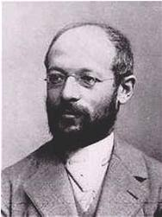
Georg Simmel (1858–1915)
One of the first sociologists to look at how the size a group affects interactions among its members
A dyad (two member group) interactions are intense and very personal ; the least stable category of groups (e.g., marriage)
In a triad (a three member group), there may be strategies that lead to competition, alliances, or mediation
Notes:
In a larger group it would be harder to exert control on individual, but on the other hand with a large group there is a possibility of the individual becoming distant and impersonal.

Slide 17
Triads
Triad refer to any structure that involves three nodes
There are 4 types of triads with undirected
transitive
Notes:
The smallest piece of society. When a third person enters a “dyad”, it transforms into a “group” (Zimmel). ….. Heider’s “balance theory” argues that people tend to seek balance in their relations. If a triad has all positive relationship, or two negatives and one positive, it is “balanced”.

Slide 18
Transitive Triad
C
A
B
A triad is considered “transitive” when A and B both have the same relationship to C
Notes:
Transitivity implies balance, and balance theory is one of the foundations of many behavioral theories
It is believed that people seek balance both toward others and objects (Heider)
If a person is imbalanced, this creates cognitive dissonance and people will try to reduce cognitive dissonance (Festinger)

Slide 19
Triads (cont’d)
In a directed graph there are 16 possible triads:
A→B B→C A→C
A→B B→C C→A
….
One can do a triad census of a network calculating the percent of triads of each type in the network

Slide 20
MAN (Mutual, Asymmetric, Null) Census
003
012
102
021D
021U
021C
111D
111U
030T
030C
201
120D
120U
120C
210
300

Slide 21
Social Balance Theory (Heider)
balanced
A
+
B
-
A
+
B
A
-
B
A
B
+
+
+
-
C
-
-
-
+
C
C
C
unbalanced
A
+
B
+
A
-
B
A
-
B
A
B
+
-
-
C
+
+
-
-
C
C
+
C
Notes:
The enemy of my enemy is my friend. Transitivity forms the basis of much sociological thinking about how people function in groups. Balance theory argued that people preferred a balanced environment with the people around them

Slide 22
Triadic closure
B
B
A
C
A
C
D
D
The Strength of Weak Ties– Granovetter (1973)
Notes:
The percent of transitive triads provides a measure of cohesion

Slide 23
Reciprocity & Transitivity
Networks with high levels of reciprocity:
Diffusion within faster; but
Diffusion between groups slower
Transitive triads also more likely to:
Increase homogeneity of opinions
Facilitate diffusion within groups, but inhibit diffusion of outside ideas

Slide 24
4 Nodes?
One might expect the next level of analysis to increase to 4 nodes, as reciprocity was 2 nodes, and triads 3 nodes, but
4 nodes takes us to groups
Of course, Q, modularity is a network level metric

Slide 25
Diameter
Diameter: Length of the longest path in the network (the maximum distance between nodes in the network)
Networks with shorter diameters are more cohesive

Slide 26
Average Path Length (APL)
Average of all the distances between nodes
Networks with lower APL are more cohesive

Slide 27
Clustering
A measure of the degree of “clumpiness” in the network
Watts re-introduced the clustering coefficient:
2 ways to measure clustering
:Average personal network density
:Percent of closed triads
Notes:
A network with high clustering indicates that nodes are connected in dense pockets of interconnectivity, whereas one with low clustering has few pockets of interconnectivity

Slide 28
Personal Network Density
x
x
A
y
B
y
z
z
PN Density = 1/6 = 16.7%
PN Density = 3/6 = 50.0%

Slide 29
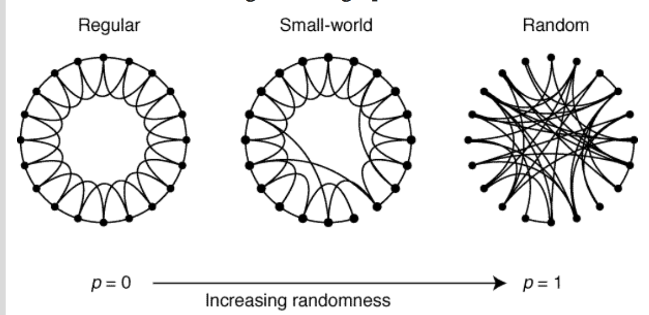
Watts & Strogatz (1998)
Notes:
Dormant for decades then revitalized by Watts & Strogatz. Characterized by: shorter path lengths than would be expected in a random network of the same size and density. Clustering can accelerate behavior and disease spread within
groups but will inhibit spread between groups.

Slide 30
Centralization
The degree ties are focused on one or a few people
Index ranges from 0 to 1 with 1 being perfectly centralized.
Recall: Centralized network are ‘scale free’ networks

Slide 31
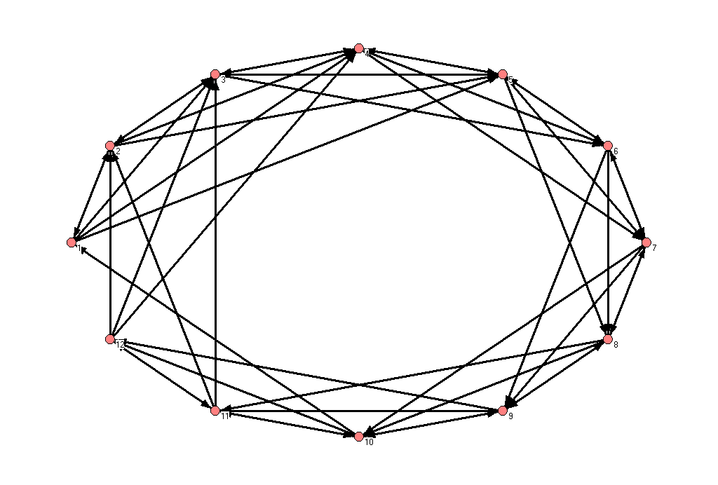
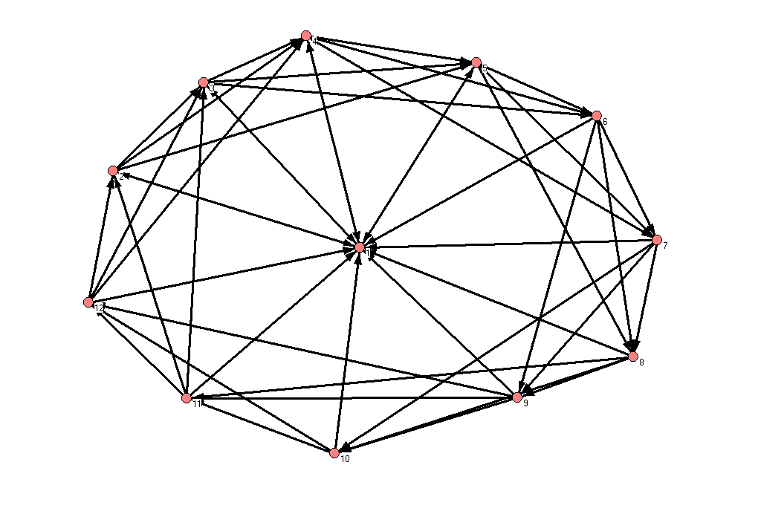
Examples of Dense Networks (Density=36.4%)
Decentralized (9.1%)
Centralized (50.9%)

Slide 32
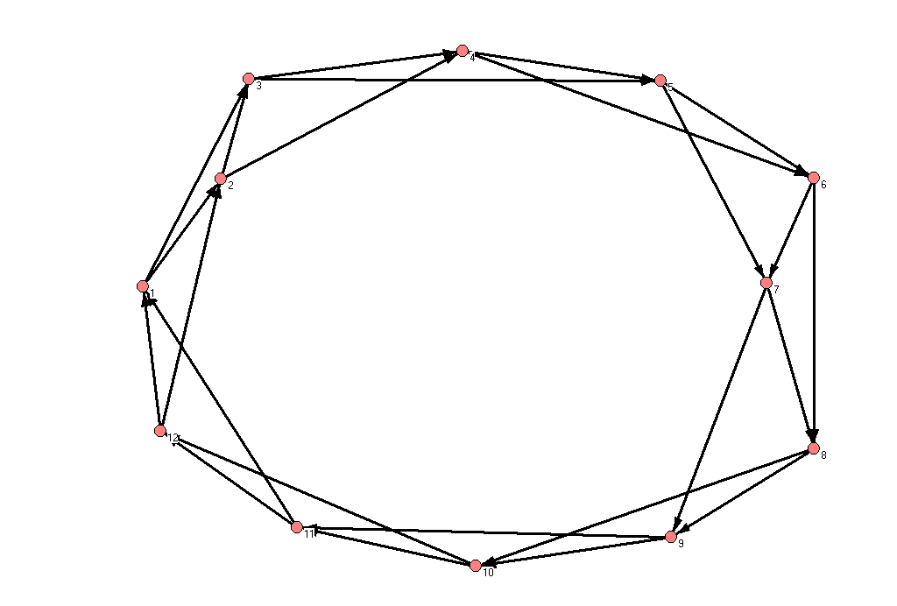
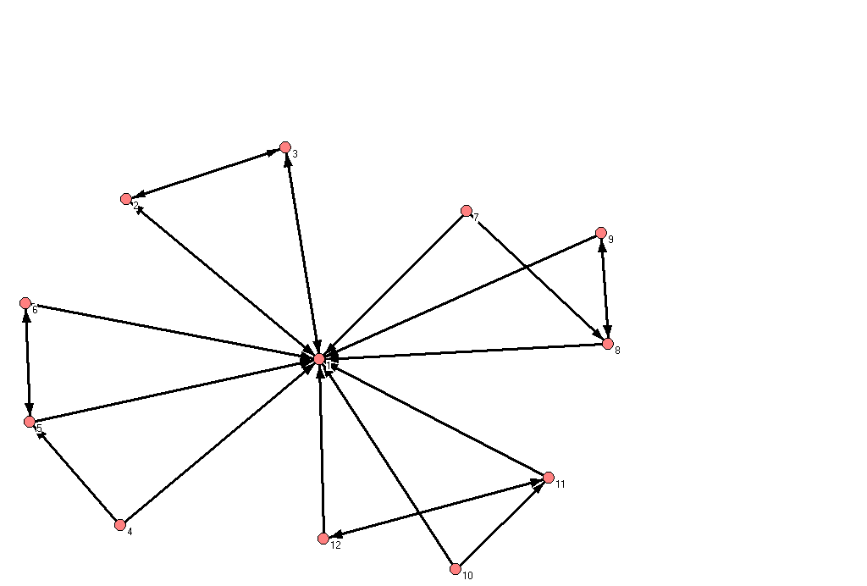
Examples of Sparse Networks
(Density=18.2%)
Decentralized (0.0%)
Centralized (87.3%)
Notes:
Thus, centralization has the net effect of placing more power and control on the central people, the opinion leaders

Slide 33
Centralization
Centralized networks should/could have fastest diffusion:
Central nodes are key players in the process
Central nodes are gatekeepers
Other properties may interact with centralization

Slide 34
Core Periphery Structures
CP Networks have cores of densely connected people and a
Periphery of those loosely connected to the core and to each other
Can test whether networks have a C-P structure
Construct this idealized matrix and correlate the ideal with the empirical.
Correlation coefficient is a measure of the CP

Slide 35
Core Periphery
Diffusion more likely to occur in the core
Take a while for behaviors to filter to the periphery
Many innovations may come from the periphery then percolate to the core
Core groups can keep infectious diseases endemic to communities – STDs, HIV, etc.

Slide 36
R code
net_size <-(network.size(know_net))
net_dense <-network.density(know_net)
net_recip1d <-grecip(know_net, measure=c("dyadic"))
net_recip1dnn <-grecip(know_net, measure=c("dyadic.nonnull"))
net_central <-(centralization(know_net, degree, cmode="indegree"))
net_components <-(components(know_net))
triad <- c(9, 12, 13, 16)
net_triads <-triad.census(know_net, mode = c("digraph"))
trans_pct2 <- ((sum(net_triads[triad])) / (rowSums(net_triads)))

Slide 37
If we have more time…

Slide 38
2 Mode Data
Recall that data on events, organizations, etc. can be used to construct 2 mode networks
E.g., in this class students come from different departments
Can construct a network based on shared dept. affiliations

Slide 39
Transposing a Matrix
Matrix A
Matrix A’ (transpose)
 | Event A | Event B | Event C
Person 1 | 1 | 0 | 1
Person 2 | 1 | 1 | 0
Person 3 | 0 | 1 | 0
Person N | 0 | 0 | 1
 | Person 1 | Person 2 | Person 3 |  |  | Person N
Event A | 1 | 1 | 0 |  |  | 0
Event B | 0 | 1 | 1 |  |  | 0
Event C | 1 | 0 | 0 |  |  | 1

